Slide 1
Modern .NET Software Architecture
Where are we today?
Christoph Pletz, CL-SOL
Manuel Meyer, ZH-AD

Slide 2
Agenda
TicTacMicroservice
A Brief History of Software Engineering
Microservice Characteristics
Microservice Examples
Inside TicTacMicroservice
Summary

Slide 3
TODO:
Tasks:
MME:
QR-Code in Präsentation einbauen.
CPL:
Demos fertig machen
Slides ergänzen
Nach Azure Deployen
Ablauf Begrüssung (1min, MME)
Free4All TicTacTech via QR Code (10min, CPL)
Slides bis TicTacTech (10min, MME)
Erklärung TicTacTech (10min, CPL)
Ausblick (2 min, MME)
Zusammenfassung (3 min, CPL)

Slide 4
TicTacTech
Hier kommt der QR Code hin

Slide 5
A Brief History of
Sofware Engineering

Slide 6
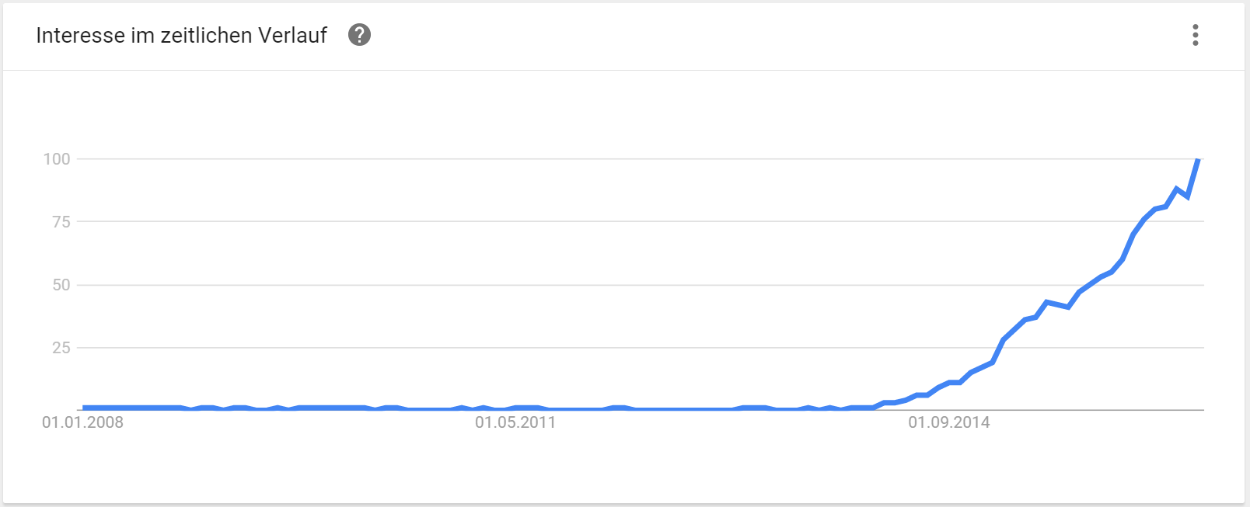
A Look Around Today
Google Trend „Microservices“

Slide 7
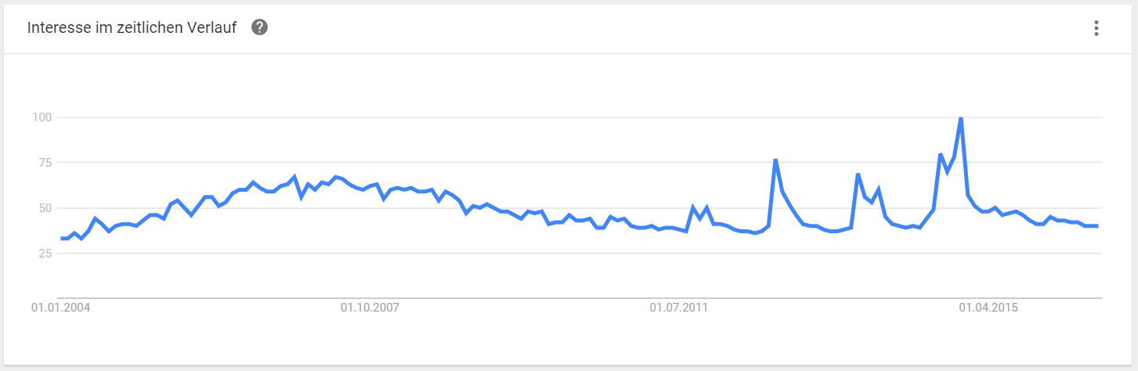
A Look Around Today
Google Trend „SOA“

Slide 8


A Look Around Today
Google Trend „SOA“

Slide 9
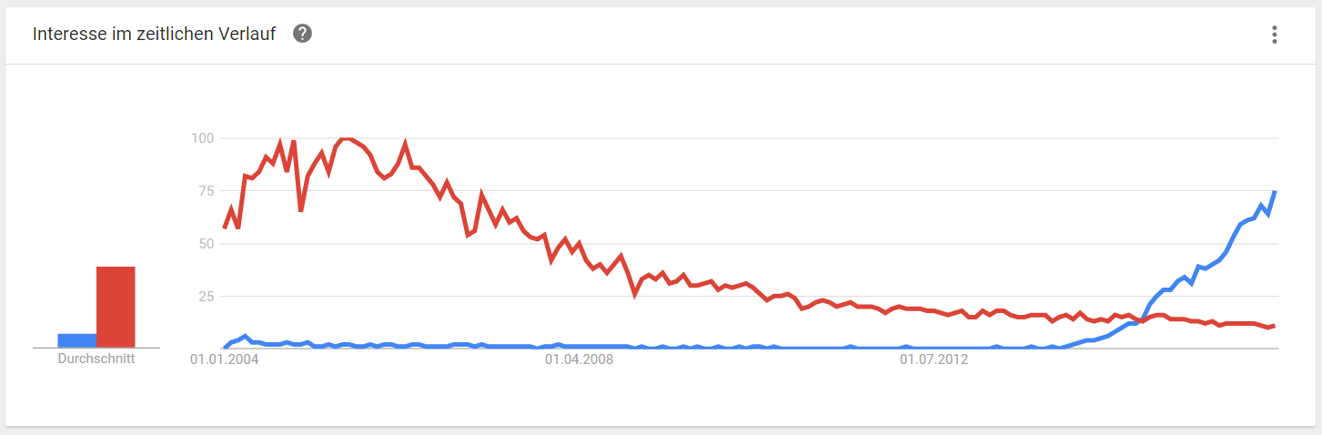
A Look Around Today
Google Trend „Microservices“ versus „Service Oriented Architecture“

Slide 10
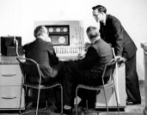
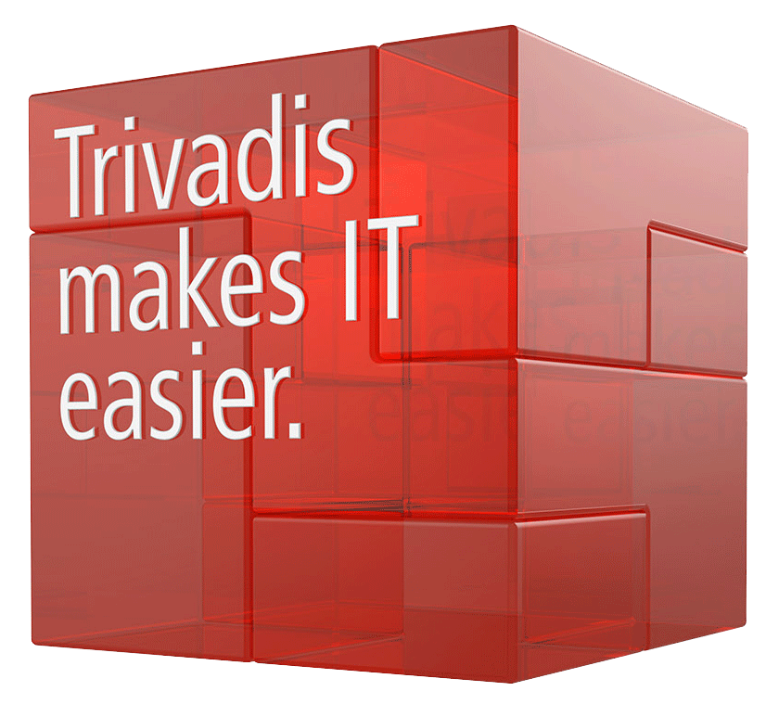
A Brief History of Software Engineering
Mark 1
09.09.2016
1940
Notes:
Mark 1 5 Tonnen sowie eine Frontlänge von 16 Metern.

Slide 11
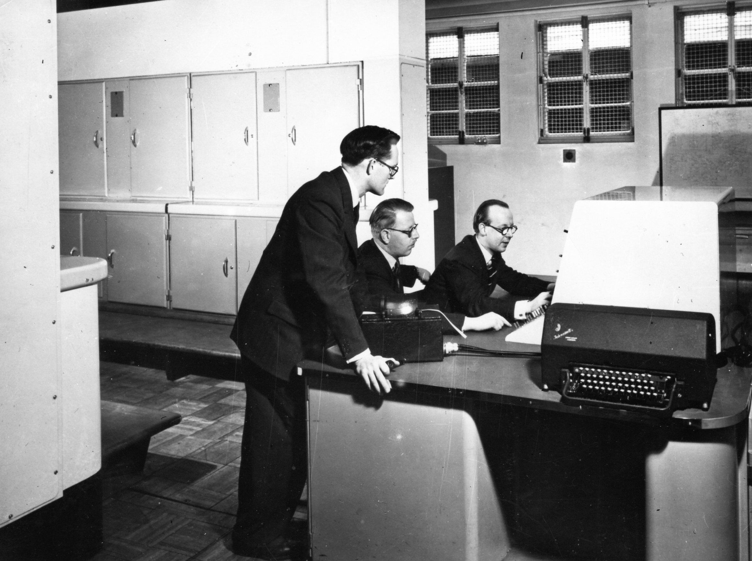
The Unix Philosophy (1978) - DOTADIW

Slide 12
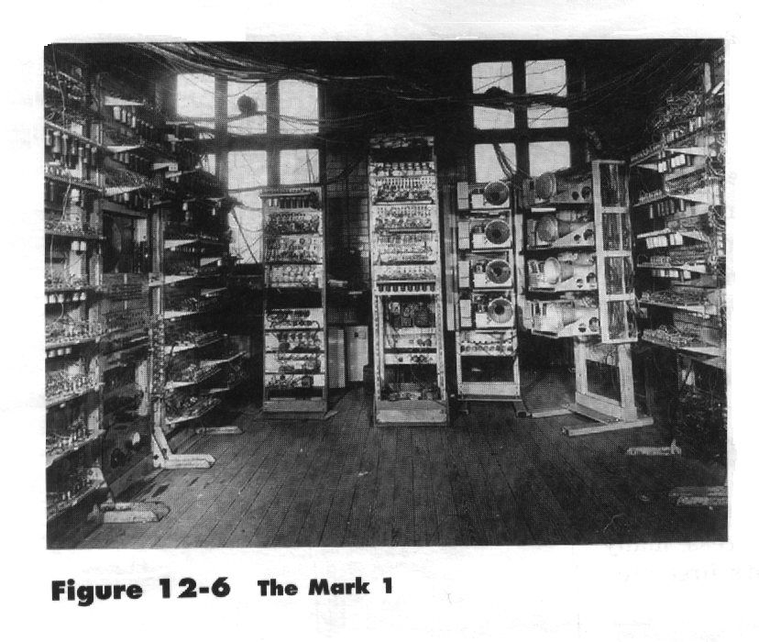

Slide 13


Slide 14

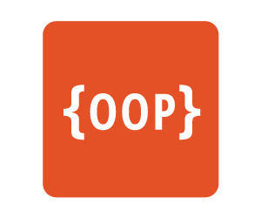
A Brief History of Software Engineering
The UNIX
Philosophy
(DOTADIW)
Mark 1
09.09.2016
1978
1940
1970
Notes:
Mark 1 5 Tonnen sowie eine Frontlänge von 16 Metern.

Slide 15
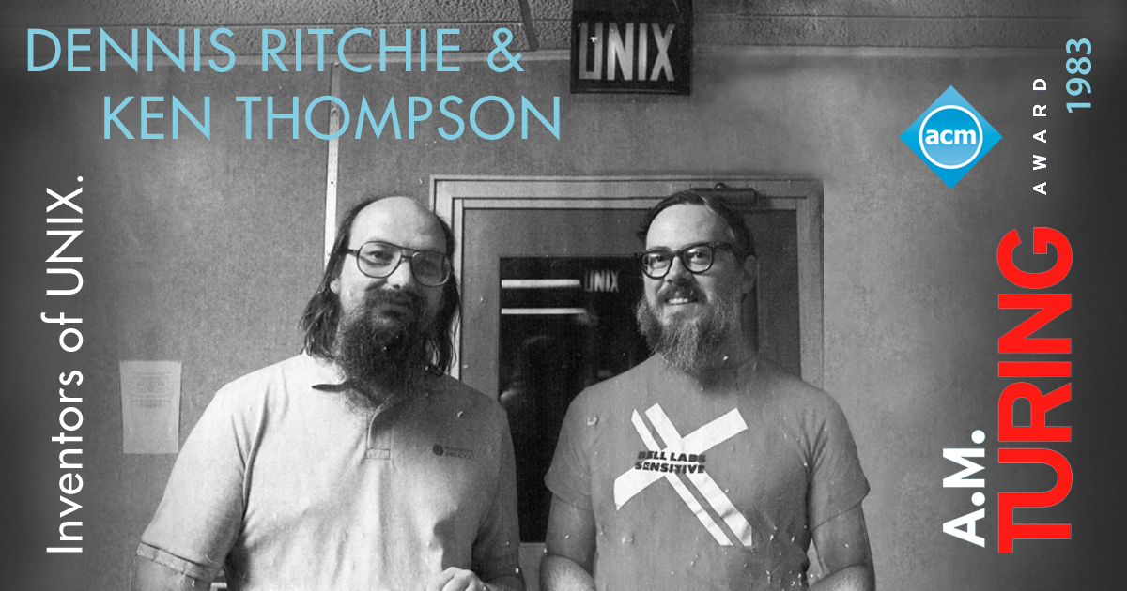
The Unix Philosophy (1978) - DOTADIW
Notes:
Ritchie: Unix, C
Thompson: B, UTF-8, Go

Slide 16
The Unix Philosophy (1978) - DOTADIW
„Do one thing and do it well“
Make each program do one thing well
Expect the output of every program to become the input to another
Design software and systems to be tried early, don‘t hesitate to throw away
Use and make tools.

Slide 17
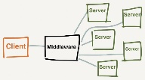



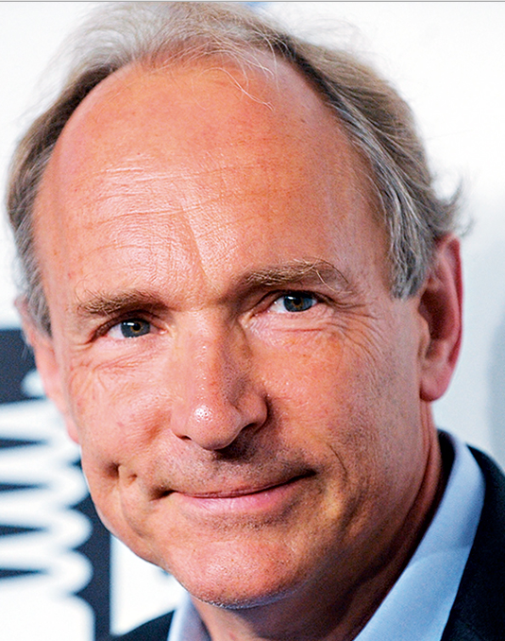

A Brief History of Software Engineering
SOA
The UNIX
Philosophy
(DOTADIW)
DDD
Agile Manifesto
Reactive Manifesto
DevOps
09.09.2016
Mark 1
1978
1996
2001
2003
2007
2013
1940
1970
1989
2000
2002
2005
2011
RESTful
Services
‘’Micro-Web-Services‘’
Microservices
WWW
The Cloud
Notes:
Mark 1 5 Tonnen sowie eine Frontlänge von 16 Metern.

Slide 18
The Reactive Manifesto
REACTIVE
Elastic
Responsive
Resilient
Message Driven
https://www.reactivemanifesto.org/

Slide 19
A Brief History of Software Engineering
SOA
The UNIX
Philosophy
(DOTADIW)
DDD
Agile Manifesto
Reactive Manifesto
DevOps
09.09.2016
Mark 1
1978
1996
2001
2003
2007
2013
1940
1970
1989
2000
2002
2005
2011
RESTful
Services
‘’Micro-Web-Services‘’
Microservices
WWW
The Cloud
Notes:
Mark 1 5 Tonnen sowie eine Frontlänge von 16 Metern.

Slide 20
Microservice Characteristics

Slide 21

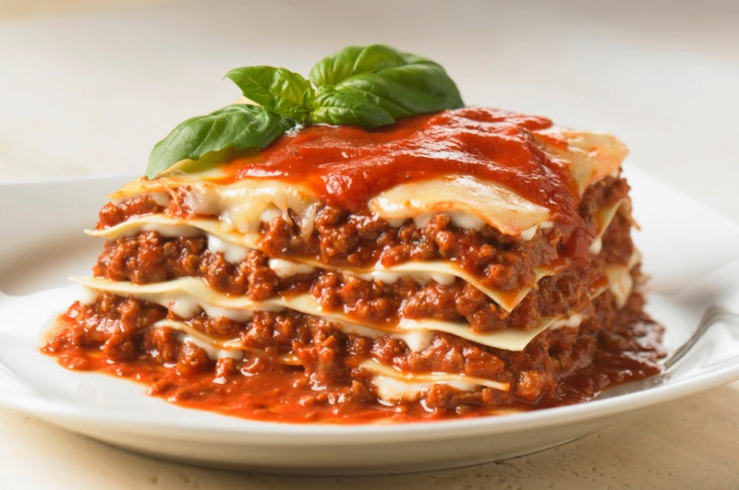
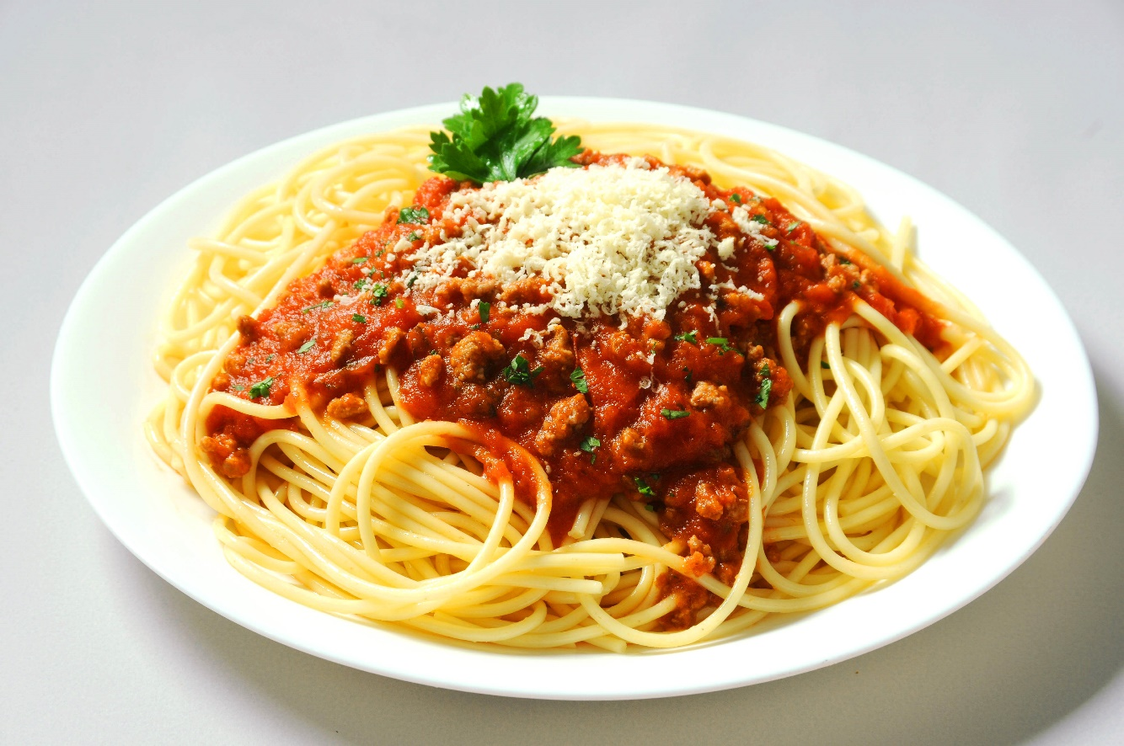
The Evolution of Software Architecture

Slide 22
Microservice Characteristics
Small and self contained
Easy to replace, individually deployable
Organized around capabilities
Implemented with „what fits best“
„Smart endpoints and dumb pipes“
Designed for failure
-> High degree of automation (Management, Continuous delivery, Continuous testing).
http://martinfowler.com/articles/microservices.html/
Notes:
Rest protocols instead of WS* or BPEL or ESB.

Slide 23
Microservice Examples

Slide 24
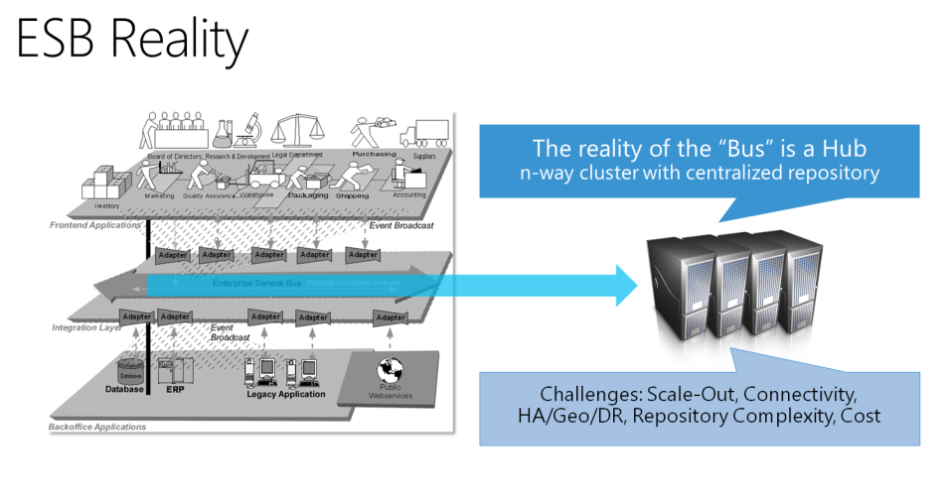
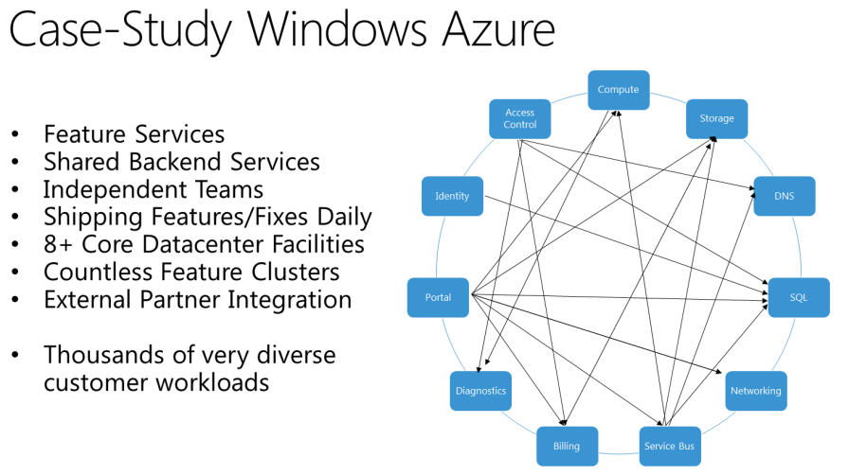
Microservice Example 1: Microsoft Azure
Clemens Vasters: Utopia ESB
http://channel9.msdn.com/Blogs/Subscribe/Wheres-the-ESB

Slide 25
Microservice Example 2
«Just Giving»
CPL: Bitte noch füllen.

Slide 26

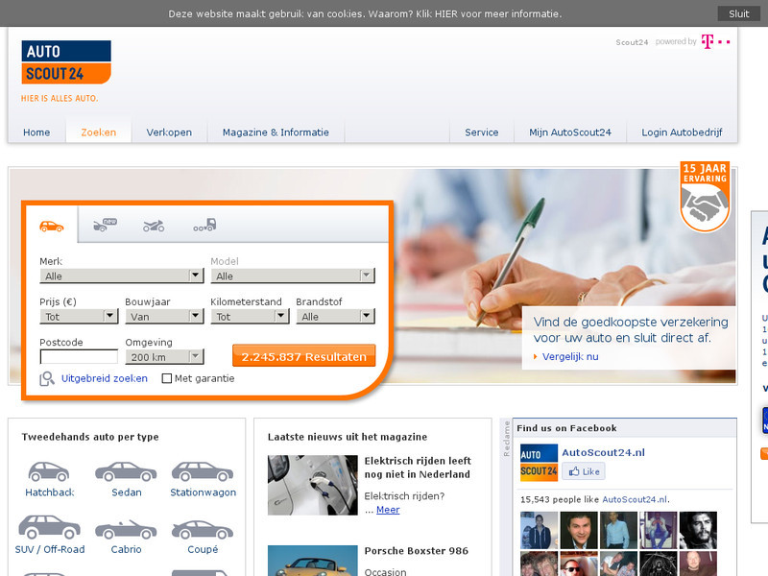
Microservice Example 3
«A High-Performance Solution to Microservices UI Composition»
NDC Oslo 2016
https://vimeo.com/171927597

Slide 27
Inside TicTacTech

Slide 28



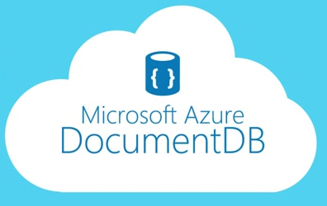



Microservice Example 4: TicTacTech
CPL: Bitte diese Slide noch erweitern und ev. weitere hinzufügen, falls nötig.
PlayerService
GameService
StatisticsService
User Interface
Azure Web Job
Service Fabric
Reliable Actors
aurelia.io
Sql Server
Azure ServiceBus

Slide 29
Summary
Da muss noch was hin.
Notes:
Rest protocols instead of WS* or BPEL or ESB.

Slide 30
Thank You!
Manuel Meyer (manuel.meyer@trivadis.com)
Christoph Pletz (christoph.pletz@trivadis.com)

